Slide 1



Immediate Postpartum LARC: Why and How
Dean V. Coonrod, Patricia Habak, Debra Welborn, LeAnn Hardin, & Joy Atkinson
Maricopa Integrated Health System (MIHS)
District Medical Group (DMG)
University of Arizona College of Medicine- Phoenix

Slide 2
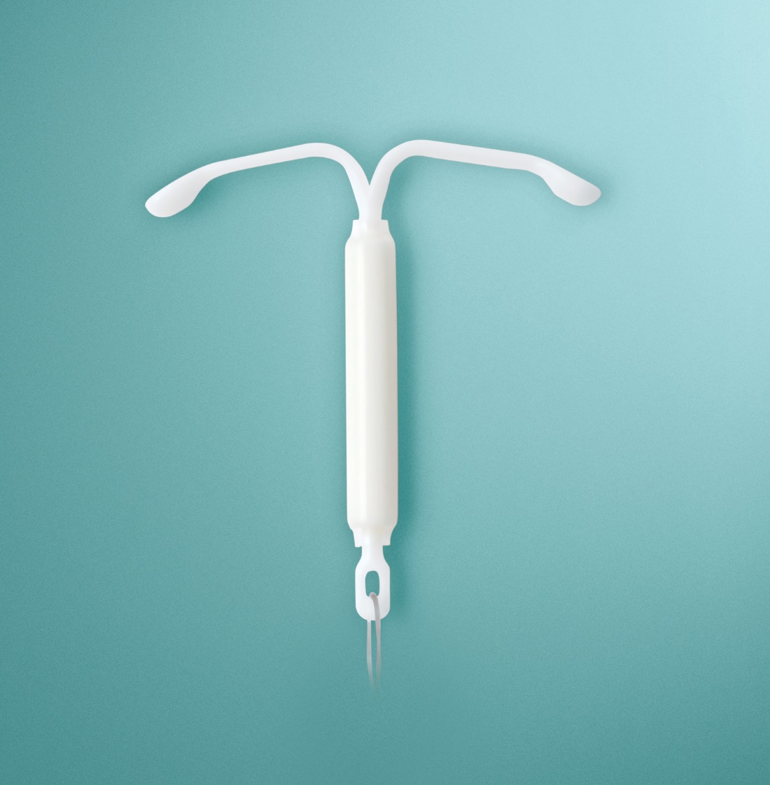
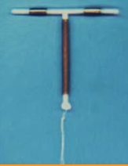
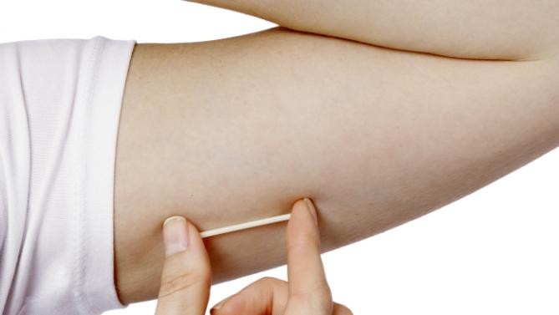
LARC
Long
Acting
Reversible
Contraception
In this talk Immediate PostPartum LARC = PP LARC

Slide 3
Disclosures
None of the authors have a conflict of interest
MIHS / DMG has received funding from
  The Ryan Residency Program in Family Planning
    Supplies PP LARC Devices
  Title V
We are a teaching institution with eager residents wanting to do PP LARC

Slide 4
Objectives
By the end of this session the audience will be able to:
  Outline the rationale for PP LARC
  List steps needed to implement PP LARC
  Access policies and other practical information for PP LARC

Slide 5
WHY?
Immediate Postpartum LARC: Why and How

Slide 6
Case
A 25 y/o G6P0505 presents to your L&D at 36 weeks by stated EGA in early labor, her contractions subside and she will be discharged home. She only has been seen in OB Triage this pregnancy. Her youngest child is 12 months old. She says this was not an intended pregnancy and would like to do something to avoid having another pregnancy so soon. She has never followed-up with a postpartum visit in her 5 prior pregnancies. She is released.

Slide 7
Postpartum Behavior at 6 weeks.
Return for 6wk f/u visit
Stop breastfeeding
Resume sexual activity
Get desired IUD
0
10%
20%
30%
40%
50%
60%
70%
Speroff Contraception, 2008
Ogburn Contraception, 2005
Halderman AJOG, 2002
Notes:
To outline why expanding access to intrauterine contraception in the postpartum period is important, we first need to review what we know about postpartum behavior.
The standard postpartum check is scheduled at 6 weeks after delivery. This is typically the visit where we address contraceptive needs for anyone who didn’t leave the hospital with a method.
Studies indicate that up to 60% of women resume sexual activity prior to 6 weeks postpartum. One study explicit instructions to abstain 6 weeks, 45% did.
About 30% of women are no longer breastfeeding by the time they come for their 6 week visit. 8% who said they were planning to breastfeed never begin and another 22% begin but stop within the first 6 weeks.
Non breastfeeding women begin to ovulate around 4 weeks postpartum.
In one study conducted in New Mexico, as many as 12% of postpartum patients requested an IUD.
In that New Mexico study, only 60% of women ever returned for their postpartum visit at all. 4 out of 10 were never even seen back.
Of those that had requested an IUD pp and did return for their 6 week visit, only 60% had their IUD inserted. Of the other 40%...

Slide 8
Rule of 3’s and Ovulation
Exclusive breastfeeding
  Mean ovulation 6 months
  Earliest 3rd month
Partial / Not breastfeeding
  Mean ovulation 6 weeks
  Earliest 3rd week

Slide 9
Pregnancies by Intent:
More than ½ Unintended
Guttmacher, Data from 2015

Slide 10
Unplanned Births in Arizona
In 2010, 51 percent of births in Arizona were unplanned.
Those births cost the state $161,500,000.
Those births cost the Medicaid program (federal and state) a total of $670,900,000.
Guttmacher, Data from 2010
Notes:
2010 is the last date for which this data is available.

Slide 11
Why Can’t They Wait?
High interest in LARC exists among postpartum women, particularly among women with a recent unintended pregnancy and women who do not desire pregnancy for at least 2 years (Tang et al., 2013).
Over half of unintended pregnancies among women in the US occur within 2 years following delivery (In Potter et al., 2014).
Many women will not show up for their 6 week visit.
Those that do may not meet CDC criteria for not being pregnant so unable to get a desired LARC
  Unprotected intercourse, not exclusive breastfeeding
Notes:
One question we get often when discussing Immediate postpartum LARC is why they can’t just wait until their postpartum visit and get it then.
Lets face it, sometimes life gest in the way of the best intentions.
The reality is that while WE could wait and come back, many women, especially poor women on Medicaid, may not return for a postpartum visit, may have the visit delayed, or may even become pregnant again prior to the new appointment.
Providing LARC immediately postpartum guarantees that the woman receives the contraception she wants in a convenient way, and also provides significant savings for Medicaid by reducing unwanted pregnancies.
Specific criteria by the CDC exist to avoid placing LARC in patients who are pregnant.

Slide 12
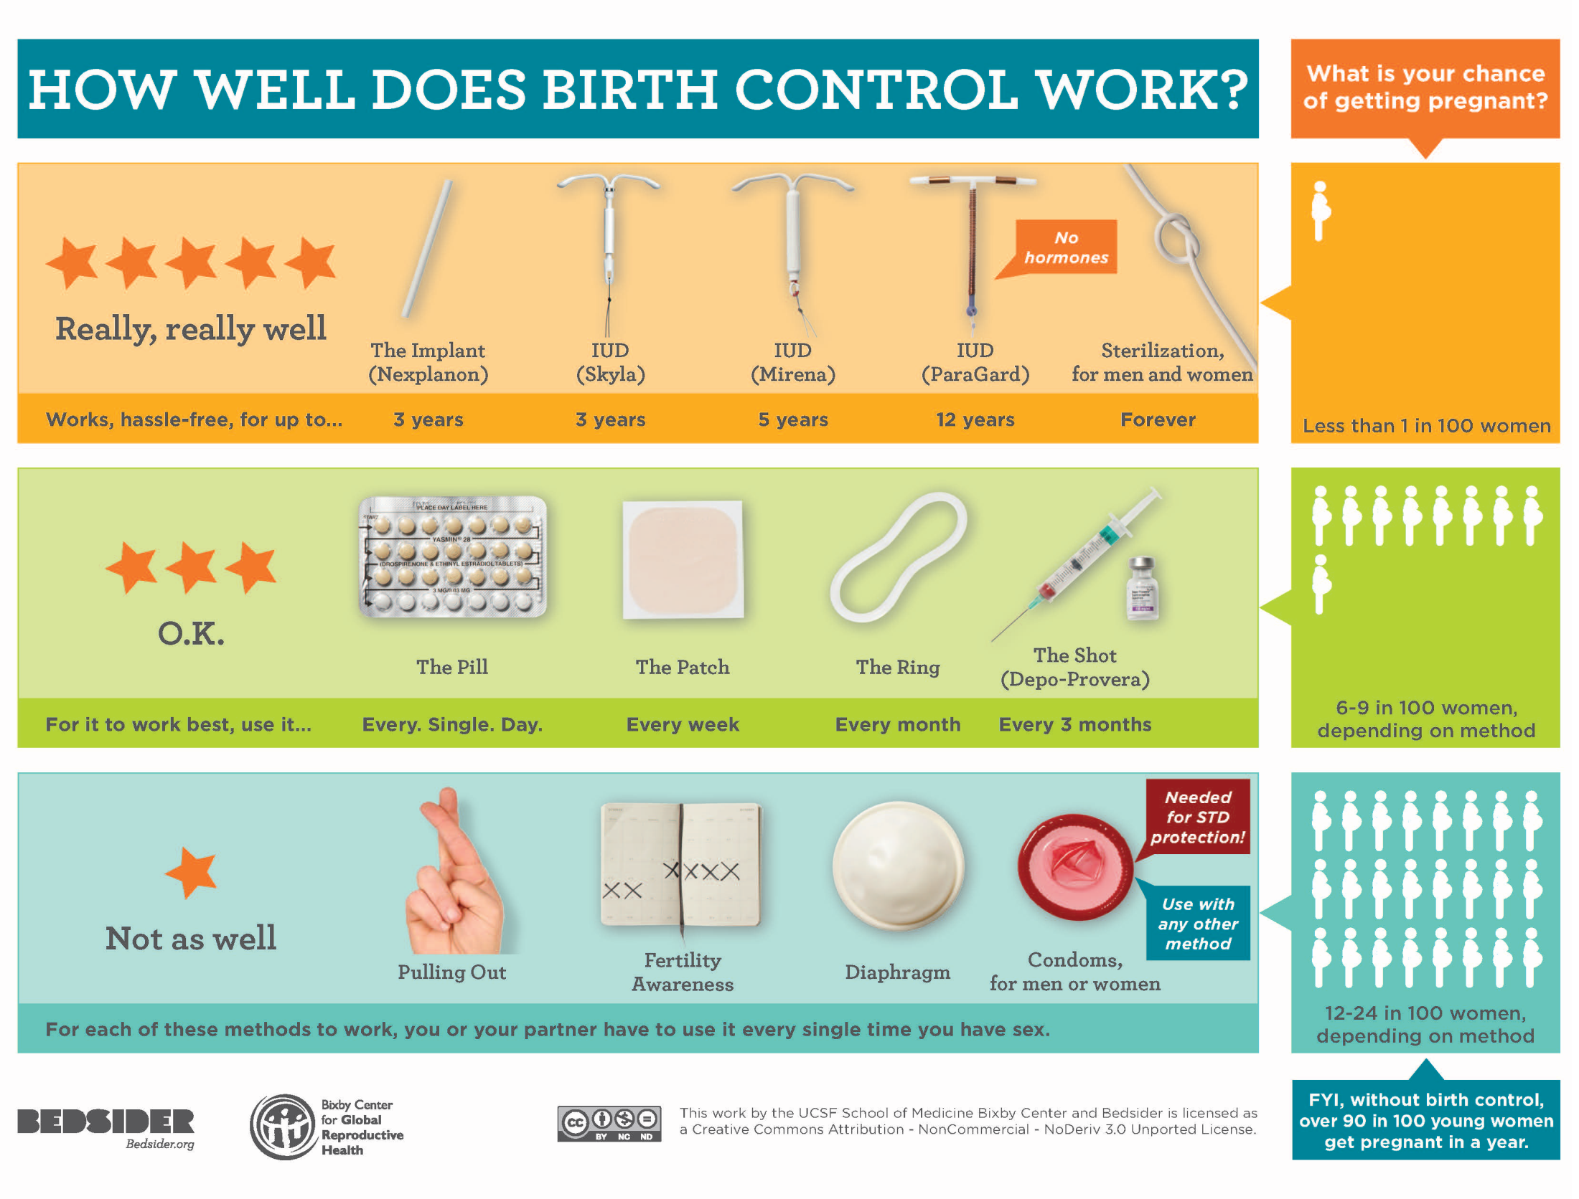
Notes:
IUDs may have a relatively high upfront cost, but their efficacy and longevity make the cost more than worth the investment. IUDs can work for up to 12 years, and only one out of 100 women will become pregnant while using one, compared to 6-9 for the pill, and 12-24 for other methods such as condoms or pulling out.
A report from the Brookings Institute concluded that the estimated annual cost to taxpayers of providing medical services to women who experience unintended pregnancies—and to the infants who are born as a result—ranges from $9.6 billion to $12.6 billion, and averages $11.3 billion.
Public savings from preventing these unintended pregnancies would range from $4.7 billion to $6.2 billion, and average $5.6 billion.

Slide 13
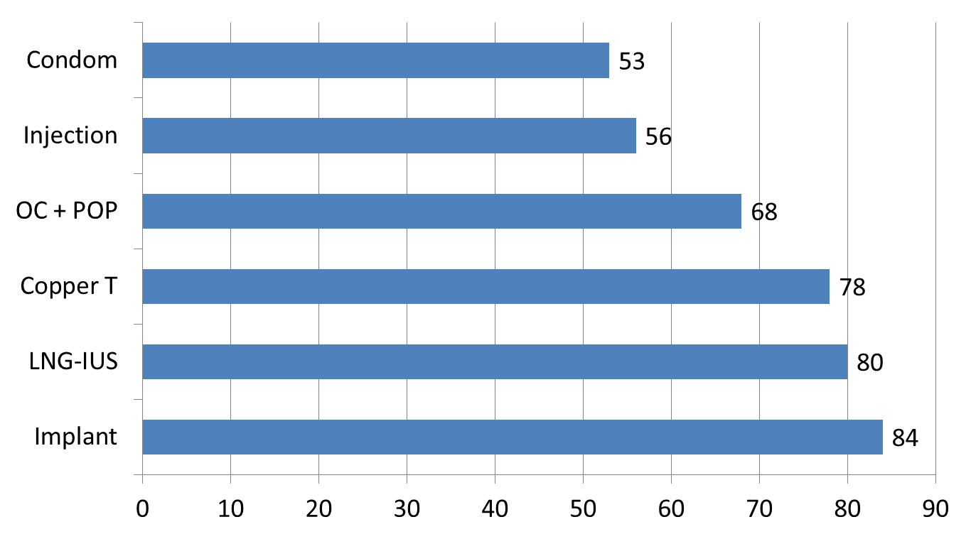
LARC Continuation Rates Are the Highest of All Reversible Methods
One year continuation rates
Continuation (%)
Trussell J in Hatcher R et al. Contraceptive Technology. 2007.
Notes:
Another myth is that the high upfront cost isn’t worth it as women tend to discontinue their chosen method quickly. In my experience, Medical Directors of health plans remember the patients who have their IUD soon removed, so to we!!
Studies have repeatedly shown that women who receive IUDs are extremely satisfied with their method and the vast majority are continuing to use the method one year out.

Slide 14
Background-
LARC and Birth Spacing
Short intervals between pregnancies carry significant health risks for both mom and baby.
Women who used LARC had almost 4 times the odds of achieving an optimal birth interval compared with women who used less contraceptive effective methods
One study estimated that the implant was associated with longer interpregnancy interval in adolescents compared with less effective methods.
Thiel de Bocanegra H, Chang R, Howell M, et al. Interpregnancy intervals: impact of postpartum contraceptive effectiveness and coverage. Am J Obstet Gynecol 2014;210:311.e1-8.
Baldwin M, Edelman A. The effect of long-acting reversible contraception in rapid repeat pregnancy in adolescents: A review. J Adolesc Health. 2013;52:S47-S53.
Notes:
Health risks include PTD, LBW, SGA, Stillbirth, Infant death

Slide 15
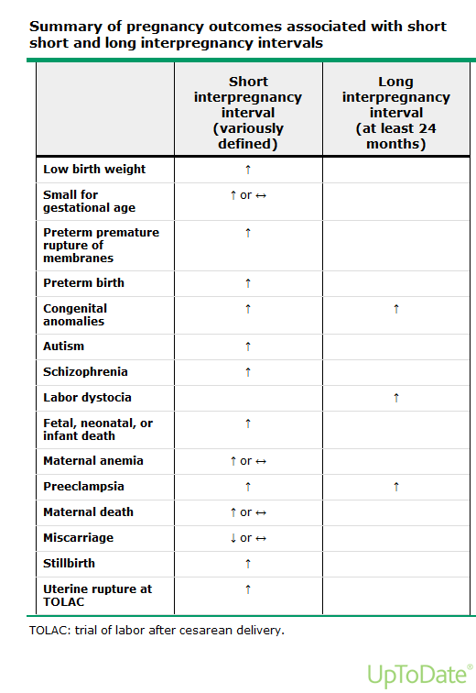

Slide 16
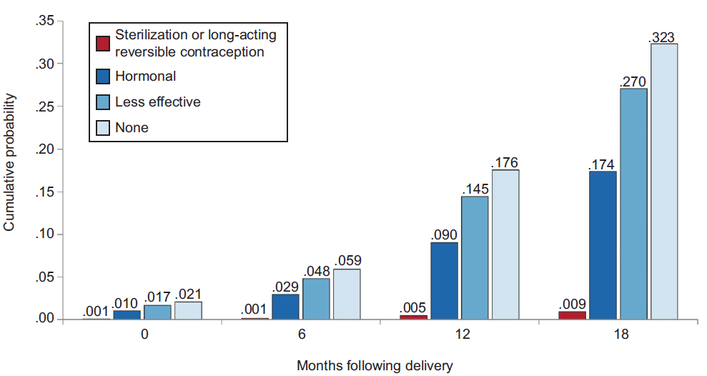
Notes:
White et al Contraception after delivery and short IPI among women in the US ob/gyn

Slide 17

4 IUDs =
$2,800
1 Medicaid
Birth =
$40,000
Notes:
4 patients with an implant to prevent one rapid repeat pregnancy

Slide 18
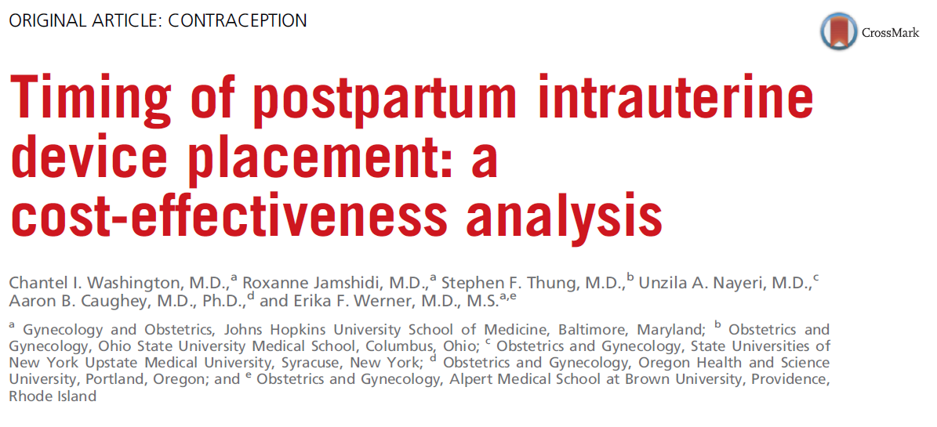
Immediate IUD insertion strategy results in
~ $282,540 savings per 1000 women over
2 year time frame.
Fertility and Sterility, Jan 2015.
Notes:
Decision analysis model to determine number of pregnancies prevented and cost effectiveness of immediate PP IUD insertion (within 10 minutes of placenta) vs routine placement at pp visit.
Assumed an 18% expulsion rate.

Slide 19
How Colorado Dropped Teen Birth Rate by 40 Percent in Four Years
  Since 2009, the state has provided 30,000 contraceptive implants or intrauterine devices (IUDs) at low or no cost.
  “teen abortion rate fell by 35 percent between 2009 and 2012”
  “the state saved $42.5 million in health-care expenditures associated with teen births.”
  Teens were 5 times more likely to be pregnant again one year later if they did not receive an immediate postpartum IUD.
Tocce KM, Sheeder JL, Teal SB. Rapid repeat pregnancy in adolescents: Do immediate postpartum contraceptive implants make a difference? Am J Obstet Gynecol 2012;206:481.e1-7.
Notes:
Another benefit to increasing access to LARC is the impact on teen pregnancy rates.

Slide 20
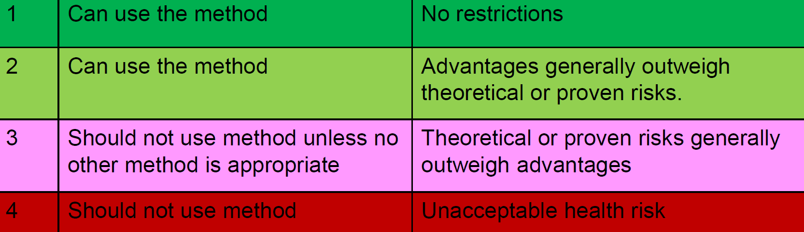
US MEC (Medical
Eligibility Criteria)
Postpartum Use | LNG IUD | Copper IUD | Implant
Non-breastfeeding, starting <21 days |  |  | 1
Breastfeeding, <30 days |  |  | 2
Breastfeeding, >30 days |  |  | 1
IUD Use, with or without breastfeeding
<10 minutes after placenta | 2 | 1
10 minutes to 4 weeks | 2 | 2
≥ 4 weeks | 1 | 1
Puerpural Sepsis | 4 | 4
Notes:
Explain too VTE risk implant unaffected
Explain 1 is good, 4 avoid

Slide 21


What About Breastfeeding?
The implant can be inserted at any time following delivery. The advantages generally outweigh real or theoretical risks if placed <1 month post-partum, and there is no restriction if placed >1 month post-partum
Observational studies of progestin-only contraceptives suggest they have no effect either on a woman’s ability to successfully initiate and continue breastfeeding, or an infant’s growth and development.
CDC MMWR June 21, 2013
Observational studies of progestin-only contraceptives suggest they have no effect either on a woman’s ability to successfully initiate and continue breastfeeding, or an infant’s growth and development. ACOG Practice Bulletin #121, July 2011

Slide 22
Avoid Placement of PP IUD
Prolonged rupture of membranes (>24 hr)
Fever > 100.4 F
Hemorrhage
Extensive genital trauma
Notes:
There are certain groups of postpartum women who are very poor candidates for insertion within the first 48 hours pp.
These include women with prolonged rupture of membranes or fever which place them in a higher category for intrauterine infection, those with intrapartum or delayed postpartum hemorrhage, and those with excessive genital trauma.

Slide 23
How: Placement Considerations
Immediate Postpartum LARC: Why and How

Slide 24
Case
The 25 y/o G6P0505 returns the next day in active labor, she is 6 cm. Between contractions she says this was not an intended pregnancy and would like to do something to avoid having another pregnancy so soon. Is she a candidate for immediate PP IUD insertion?

Slide 25
Should Everyone Get One?
Immigrants
Uninsured or underinsured
Poor compliance with prenatal visits
Pregnancy very high risk
Socially complicated
  Adolescents
  Substance abuse
Expulsion
Access
Notes:
With a higher expulsion rate, I recommend reserving postplacental or immediate postpartum insertion of an IUD to select subgroups of women. However, these subgroups will include a high proportion of women that we care for…
Immigrants who may not be able to access care regularly outside of pregnancy.
Those with no insurance or whose insurance will expire after pregnancy.
Women who have demonstrated difficulty with frequent prenatal visits may be at particularly high risk of not returning for the 6 week visit.
Women for whom another pregnancy might be devastating, such as those with risk factors that make pregnancy high risk.
Those women who have social barriers to returning. For example, adolescents who may have school or rely on parents/friends to bring them or patients who struggle with substance abuse.
For other patients who feel they can comfortably use a bridge method and return for insertion at 6 weeks postpartum, it may not be worth accepting the higher risk of expulsion.

Slide 26
Informed Consent Important
We don’t do consents for tubal ligations in labor maybe not for LARC?
We need to watch / recognize our biases
  Study of standardized cases for IUD insertion
    Physicians more likely to recommend IUD for low income women of color than low income white women
Access considerations not restricted to placement but removal too

Slide 27
Strategies to Promote Autonomy and Justice with PP LARC
Don’t introduce the subject in labor
Consider that removal may be difficult to get done
Careful of biased recommendations
  “Directing groups with the highest rates of unintended pregnancy to LARC has historical legacies”
Reproductive Life Plan approach
  Will you want more children in the future?
  When will that be?

Slide 28
Combine Approaches to Counseling
Informed choice
Shared Decision Making
Promotes autonomy
Directive Counseling
Maximizes Efficiency

Slide 29
Case
Ideal time for
consent for
PP LARC
A 25 y/o G6P0505 presents to L&D at 36 weeks by stated EGA in early labor, her contractions subside and she will be discharged home. She only has been seen in OB Triage this pregnancy. Her youngest child is 12 months old. She says this was not an intended pregnancy and would like to do something to avoid having another pregnancy so soon. She has never followed-up with a postpartum visit in her 5 prior pregnancies.

Slide 30
Case
She is counseled about PP LARC at the triage visit and would like a copper IUD.
She then comes in 24 hours later at 6 cm and quickly delivers vaginally with no complications. Unfortunately the chart is not consulted in time and there is no IUD available.
30 minutes later the IUD arrives from the pharmacy, should you place the IUD?

Slide 31
Timing of IUD Insertion
Post-placental:
within 10 minutes
Late postpartum:
> 4 weeks
Immediate:
within 48 hours

Slide 32
 | Perforation | Expulsion | Pregnancy | Removals
Postplacental | 0 | 4-19% | 2.4% | 1.8-16%
Within 48 hours | 0 | 11-16% (6-55%) | 4.7% | 8-10%
6-8 weeks | 0-2.3% | 3-11% | 5.9% | 1.4-17%
Kapp Contraception, 2009
Notes:
A recently published review, summarizing approx 15 trials that examined differences in outcome based on timing of insertions allows us to estimate the rate of perforation and expulsion by timing.
Studies differed in design and quality.
Perforations were uncommon and none were recorded in the postplacental or within 48 hour groups.
Expulsion averaged about 10% when inserted within 10 minutes of placental delivery. There was a much wider range of expulsions reported for insertion between 10 minutes and 48 hours but the highest quality studies suggested a rate of 11-16%. Interval insertion at 6-8 weeks postpartum were mostly in the 3-5% range. Expulsions were most likely to occur during the first 3 months.
Pregnancy was also uncommon.
Removals at 6-12 months for either pain or bleeding were similar between postplacental and within 48 hour groups compared to the 6 week group.

Slide 33
 | C-Section | Vaginal
Expulsion | 11-14% | 16-19%
Removal for bleeding/pain | 11% | 12%
Kapp Contraception, 2009
Notes:
Expulsions and removal in studies comparing vaginal to C/S in the postplacental period demonstrate a slightly higher expulsion rate after vaginal delivery and similar rate for removals during the first year.

Slide 34
Immediate vs Interval* IUD Insertion
Probably higher rate of expulsion (2-4 times higher)
  Counsel about this risk, need for follow up
RCT of this
  Continuation rates 83% vs 64% at 6 months
    Interval group
      39% never got IUD
      25% no show to PP visit
      14% either declined or unable to place IUD
40-75% of those planning IUD don’t get it
Cohort study comparing immediate vs delayed
  71% immediate obtained it
    vs
  7% interval group
* at the PP visit or beyond
Notes:
Including unrecognized expulsions

Slide 35
How: Placement*
Immediate Postpartum LARC: Why and How
* Note implant no different than normal

Slide 36
Insertion Technique- SVD
After delivery of placenta
  massage uterus
  administer pitocin per protocol
  Repairs tears after IUD
No additional anesthesia required
Palpate uterus and identify fundal height
Replace sterile gloves
Load the IUD in a ring forceps
Use a hand or retractor to visualize the cervix
Apply antiseptic solution to the cervix
Grasp the anterior lip of the cervix with a ring forceps
Notes:
These techniques were described in 1992 in a paper published in contraception and based on some preliminary work done by the World Health Organization.

Slide 37
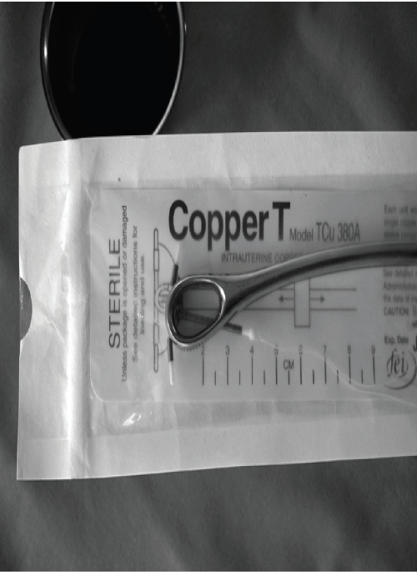
Notes:
All of the early work with postpartum IUD insertion was done with copper IUDs and there is still very little published regarding specific techniques to use with LNG IUD. However, the proper way to grasp the IUD is the grab the arms flush with the tip of the forceps but at an angle so that the tail and strings hang to the side of the forceps.

Slide 38
Insertion Technique- SVD
Insert the IUD through the cervix
Transfer non-dominant hand to the abdomen/fundus
Confirm fundal placement with both ring forceps hand and abdominal hand
  Can confirm with ultrasound post procedure or PRN
Once at the fundus, open the ring forceps, rotate 45˚, move laterally, and remove
Remove the ring forceps from the cervix
Trim the strings flush with the cervix
  Copper don’t cut
  LNG yes at cervix
    Consider cutting before placing

Slide 39
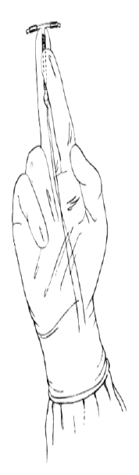
2 Other Techniques
Manual
Inserter
Notes:
Manual insertion more uncomfortable than using rings. Difficult once lower uterine segment begins to contract.

Slide 40
Insertion at Time of C/S
Manually insert the IUD to the fundus and carefully release
  Can also use inserter or ring
  No need to suture
Place the strings just at the internal cervical os (will need to trim LNG IUD strings)
Some describe pushing strings through the cervix with a ring forceps
Suture the uterine incision
Notes:
One study described pushing the strings through the cervix using the copper 380T IUD inserter

Slide 41

Post Insertion
Post-insertion instructions
2 week visit for string trim
Notes:
Be sure to give good post-insertion instructions, especially regarding expulsion. Anticipated side effects may be well tolerated and bleeding and cramping are normal after delivery.
Whether the IUD is placed after vaginal delivery or C/S, the strings are likely going to lengthen as the uterus involutes.
Because the strings will lengthen as the uterus involutes, the general recommendation is to see patients for a 2 week check to trim the strings as needed. May need to trim them again at the 6 week visit.

Slide 42
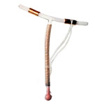
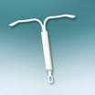
Strings 12cm and may disappear
Has no effect on breast feeding
Strings longer and less likely to disappear
Very little data to date
Regarded as safe during breastfeeding
Notes:
An important clinical question that remains is whether a copper IUD or LNG IUD are preferred for postpartum insertions.
Hayes et al completed a pilot study using the LNG iud immediately after placental delivery and found expulsion rate of 10.5%, no infections, no perforations. (n=20)
My opinion is that the choice of IUD should be based on patient preference for the type of IUD she would desire.

Slide 43
Insertion Video / Web-Based Training
You Tube
https://www.youtube.com/watch?v=uMcTsuf8XxQ
Web-based training free from Cardea
http://www.cardeaservices.org/resourcecenter/inserting-long-acting-reversible-contraception-larc-immediately-after-childbirth
Notes:
Start video at 12:28

Slide 44
How: Getting it done Locally
Immediate Postpartum LARC: Why and How

Slide 45
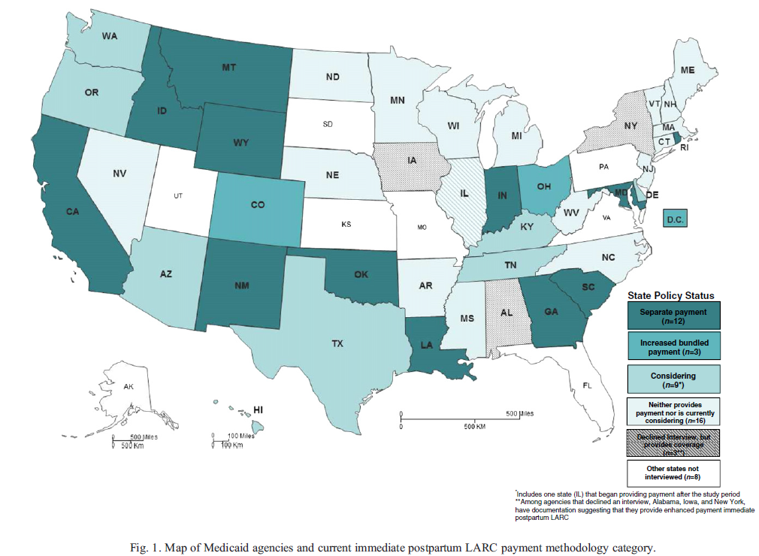
Is it Covered? AHCCCS / Medicaid
Arizona now
dark green!
Covered!!
Pre 2016
  Medical Director, “Sure you can do it as part of your global fee.”
  Cost to hospital $500 to $1,500
Now per CMS / AHCCCS
  PP LARC an add-on procedure separately billable

Slide 46
Coding Logistics
Some states provide a credit adjustment at the end of the year for inpatient LARC codes submitted at the same time as the pregnancy claim.
Other states allow providers to add a modifier to their pregnancy claim for a second procedure on the same day and will reimburse IUD placement in addition to the pregnancy claim
Some allow providers to use the same code as an outpatient LARC placement despite the service being provided inpatient.
  AHCCCS FFS Provider Manual Chapter 11 Section 33 LARC
    Use a form 1500 with is usually outpatient
    J Codes for 3, 5 year hormonal IUD, copper IUD, implant
Notes:
The Centers for Medicare and Medicaid Services has given their consent for each state to handle reimbursement for immediate postpartum LARC how they see fit.
They support the implementation of new policies to cover immediate postpartum LARC outside of the global pregnancy fee, but leave the reimbursement mechanism to each state..
Each state has chosen slightly different ways to allow physicians to bill for this service: Some reconcile at the end of the year, some reimburse under a modifier, and some allow inpatient use for outpatient codes.
CMS only requires the use of the proper device J codes and any ICD-10 surgical codes that apply.
J Codes J7297 3 yr LNG IUD 52 mg; J7298 5 yr 52 mg LNG; J7300 Copper IUD; J7301 LNG IUD 13.5 mg; J7307 Implant

Slide 47
How: Implementing Postpartum LARC at your facility
Immediate Postpartum LARC: Why and How

Slide 48
Implementation Science
Some barriers and solutions:
Inpatient pharmacy
  Stocking expensive devices
Hospital practices
  Policies / procedures
  Clinicians to do procedures
Nursing
  In-services
Pediatricians
  Issues with breastfeeding
IT
  Documenting / billing
Finance
  Coding / billing / working with payers
Study of methods to integrate evidence-based research into practice
Identify barriers and solutions

Slide 49
3 Phases Identified with Key Players & Steps
6 months
typical
Key first steps
  Identify project champions
  Broad implementation teams
  Obtain financial reassurance
  Administration awareness and/or approval
Realize bringing something new to inpatient setting
Communication vital
Exploration
Installation
Implementation & Sustainability
Hofler et al Obstet Gynecol 2017
Notes:
They published a stage-based guide which will be available

Slide 50
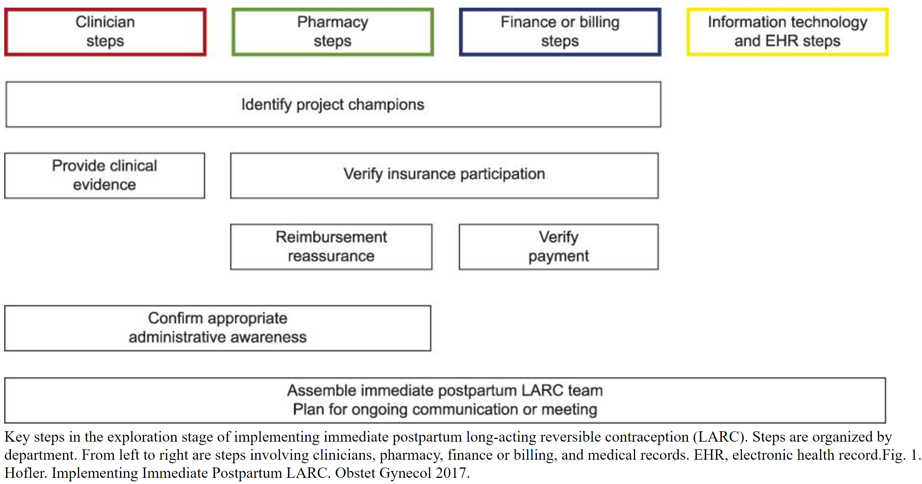
Exploration

Slide 51
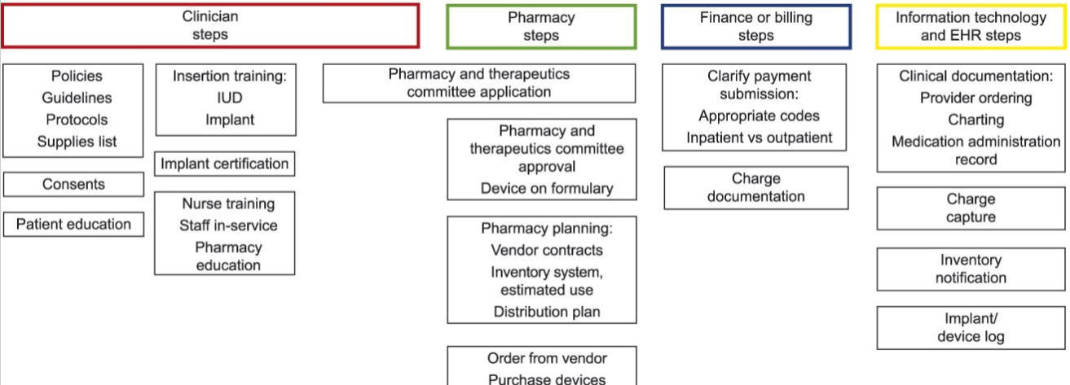
Installation

Slide 52
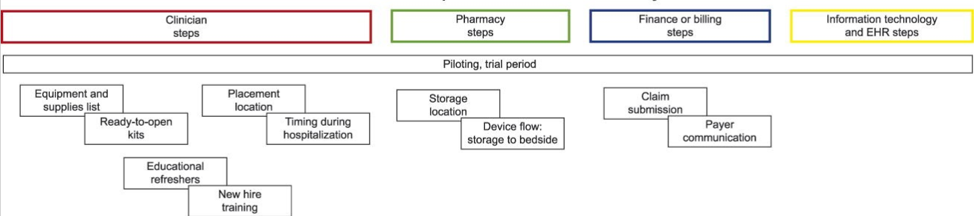
Implementation and Sustainability

Slide 53
MIHS Barriers and Solutions
Nursing staff
  Supportive from the beginning
Resident support >> attending support
  Lectures with simulation from invited guests
Pharmacy
  Overall supportive, 2-3 meetings prior to implementation, with meetings after to problem solve
  Barrier to carrying 5 yr LNG IUD vs 3 yr IUD
Multitude of Plans / Including Undocumented
  Care coordinator placing notes in chart “clearing” patient
  Multiple in-services of pharmacy, residents, staff
  Some plans require pre-auth

Slide 54
MIHS Barriers and Solutions
Preparation for placement
  Simple kits created for IUD insertion and implants
IT / EMR
  Create / place discharge paperwork into d/c instructions
Disjointed prenatal care from “hospitalist” practice
  Communication via problem list (EMR the same for prenatal care and inpatient to assure right IUD placed, re-confirm patient wants PP LARC
  Considering time-out prior to procedure
  Billing
    Devices need to be AHCCCS approved- all IUDs are, except Kyleena which might be by August 2017
    Billing Department must agree to bill device separately on 1500 claim forms; this is an added step.

Slide 55
MIHS Results to Date
Twenty (20) Immediate PP IUDs Inserted (Includes both AHCCCS & Ryan) December 1, 2016 –June 15, 2017.
  Three (3) In Place- (Not Expelled) (2 of 3- trimmed strings on PP visit)
  Three (3) Expelled
  Seventeen are unknown (e.g. did not return for PP visit, needs US to confirm placement, too soon for PP visit)
  Eight of the 20 were teens (15-19 years old)
Implant has been popular about 40 placed in the same time-frame

Slide 56
Other Barriers and Solutions
Lack of antepartum counseling
  Assure that all providers, including outpatient, know and counsel about immediate PP LARC
Providers worried about time commitment
  Experience that not much different time than in-office
Providers are concerned about wasted products from expulsion
  Gather data
Lack of availability of devices at the bedside at delivery
  Stock IUDs on L&D units (in pyxis instead of inpatient pharmacy)
Integrating insertion of devices into L&D practice
  Checklists for insertion, integrating consents into hospital practice
  Policies not always needed!

Slide 57
Other Barriers and Solutions
Integrating insertion of devices into L&D practice
  Checklists for insertion, integrating consents into hospital practice
  Policies not always needed!
Inpatient pharmacy not used to multiple products for one indication.
  Education / work with inpatient pharmacy May need P&T committee for formulary approval
Lactation support
  Data / education about lack of effect of progestins on breastfeeding success

Slide 58
Supplemental Materials Available
Via https://www.dmgaz.org/dean-coonrod-presentation-arizona-perinatal-trust/
  This PowerPoint ☺
  Current resource page ACOG / Immediate PP LARC
    Includes Cardea web-based training link
  Hofler 2017 implementation article with supplement
  South Carolina toolkit

Slide 59
Questions?

Slide 60
How: Supplemental Slides
Immediate Postpartum LARC: Why and How

Slide 61
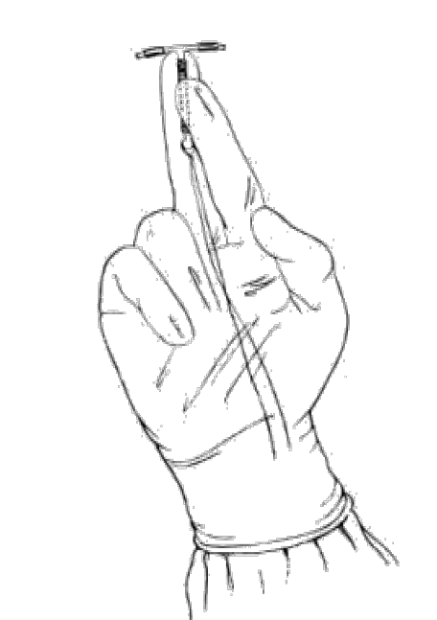
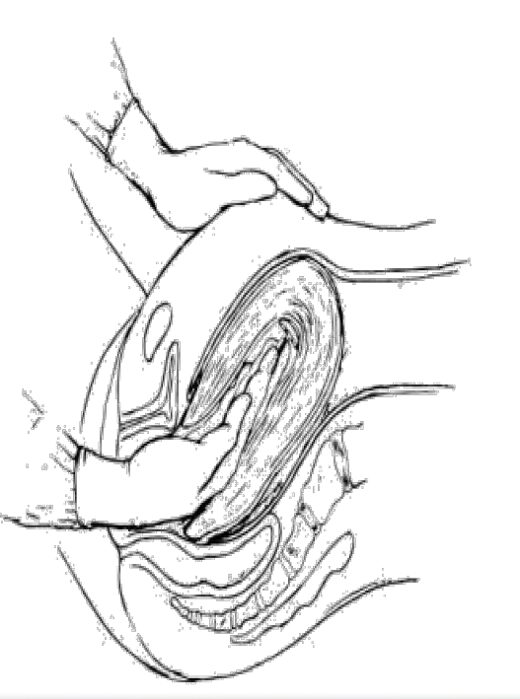
Manual Insertion
Hold IUD gripping vertical rod b/w index & middle fingers of dominant hand, strings on palm
Insert IUD holding hand to abdominal hand which has uterus firmly held
Don’t dislodge IUD as remove the hand

Slide 62
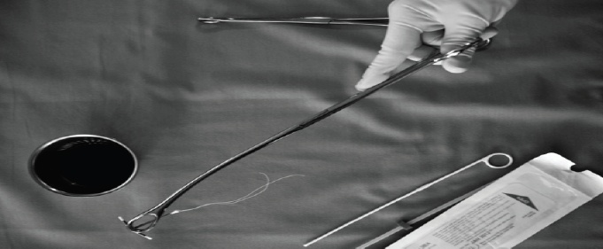
Ring Forceps 1
Grasp anterior cx with rings
Place IUD on 2nd ring
  Hold IUD by vertical arm / wings
  Horizontal arm slightly out of ring but in same plane as ring but tilted
  Close gently around IUD

Slide 63
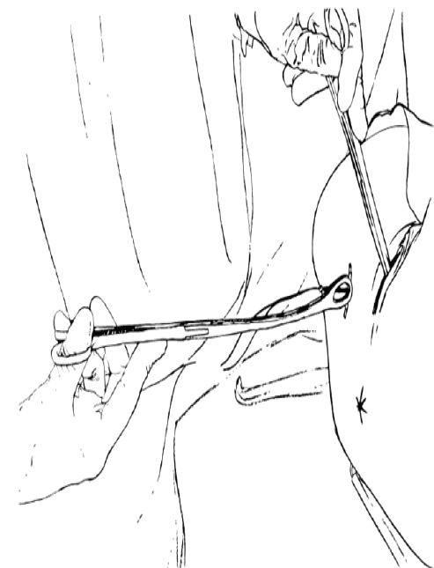
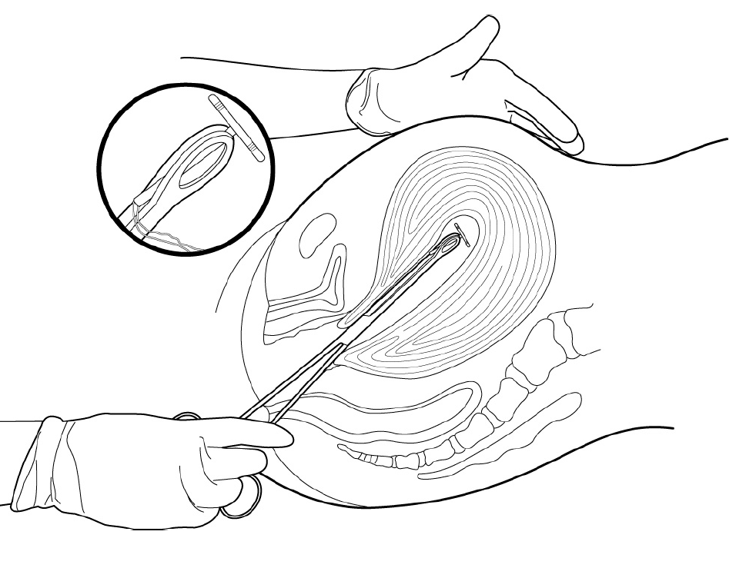
Ring Forceps 2
Place traction on cervix
Place IUD through vagina/cervix
Switch with non-dominant hand to fundal pressure
Maintain orientation of the forceps
Angle to umbilicus, not cephalad, by placing hand holding forceps downward

Slide 64
Ring Forceps 3
Open forceps at fundus to release IUD
Keep forceps open, rotate 45˚and sweep laterally to avoid strings
Remove forceps from uterine cavity
Post insertion tasks
  View cervix
  Check string length – too much not at fundus
  Remove forceps holding cervix

